Slide 1
P.S. 24Q
Mathematics Exam 2017
JRajwan@schools.nyc.gov

Slide 2
Important Dates to Remember!
NYS MATH | Tuesday, May 2 | Wednesday, May 3 | Thursday, May 4

Slide 3
What is PS 24 doing to get your children ready for the CCLS aligned test?
GOOD INSTRUCTION IS TEST PREP!
Teacher teams have attended test sophistication workshops & professional development sessions to support their understanding of the test & how to align their teaching to support the CCLS
PS 24 purchased test preparation materials to support math test sophistication in Grades 3-5.
Students have been receiving targeted small group instruction in math during the day
Selected students have been receiving targeted small group instruction, outside the classroom, to ensure success on the math exam.
Selected students have been invited to Extended Day and Morning Shine to further hone in on their skills in math.
Students have been learning a variety of test preparation skills through out the day, as it is embedded into our instruction!

Slide 4

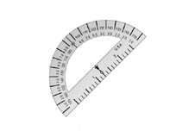
Old vs. New
In the past, we saw this on the tests…
      Use your ruler to help you solve this problem.
      This picture means that you will use your protractor.
Now, tools are given at the beginning of the test and students need to know when to use them or when not to use them
    Grades 3-5 will all have rulers
    Both 4th and 5th grade will have both rulers and protractors

Slide 5
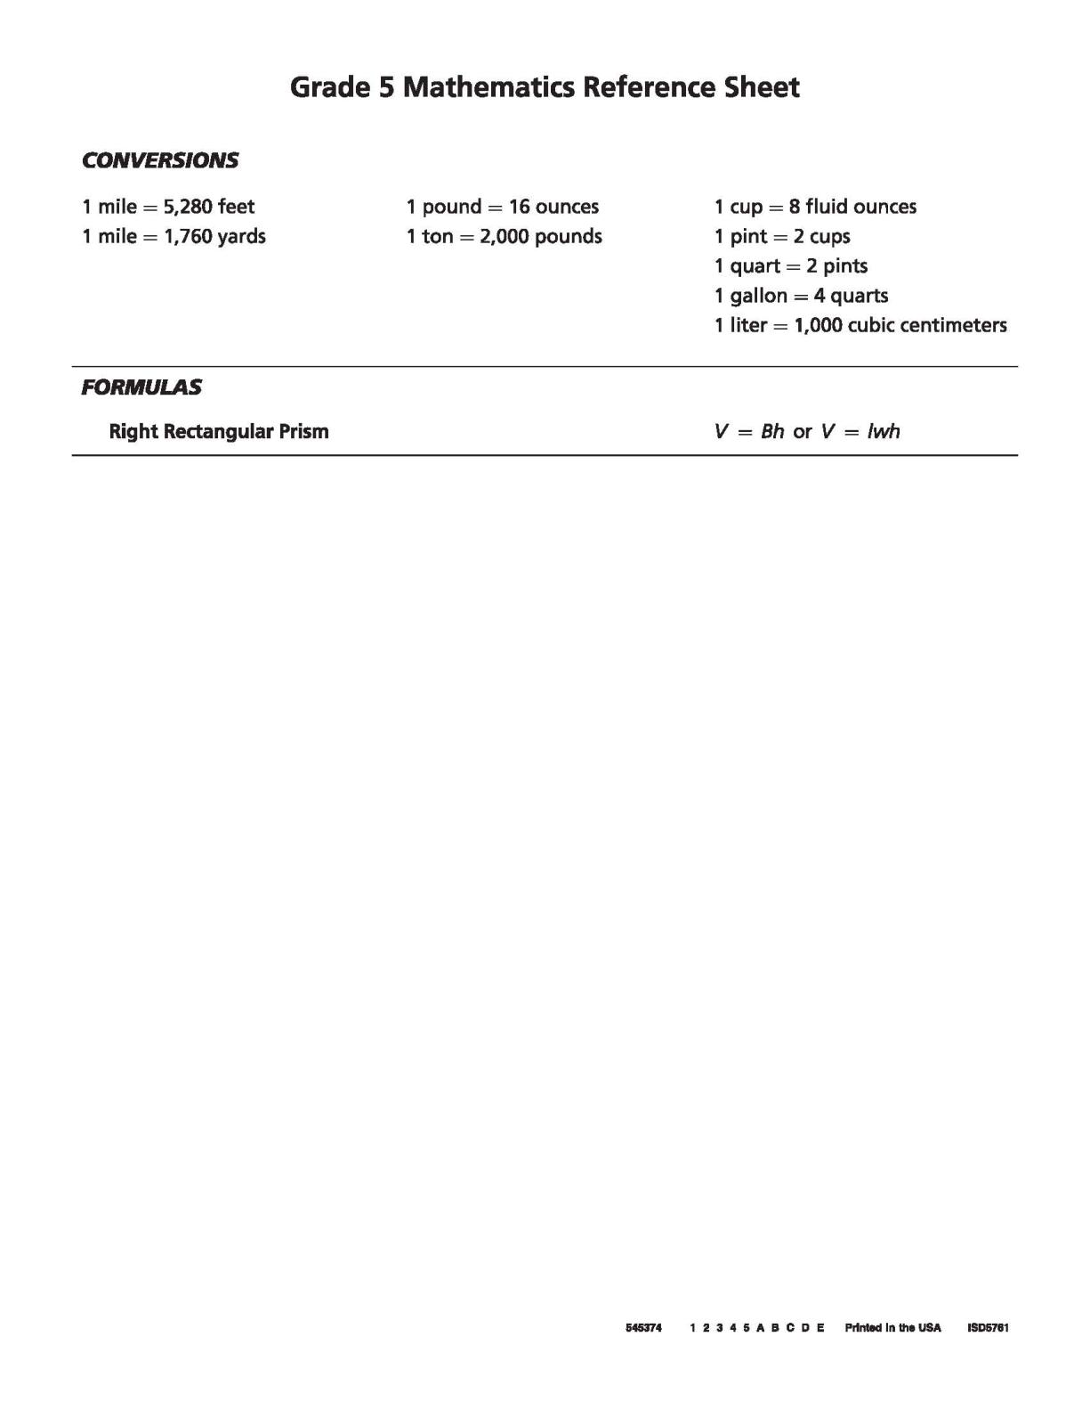
Grade 5 Mathematics Reference Sheet

Slide 6
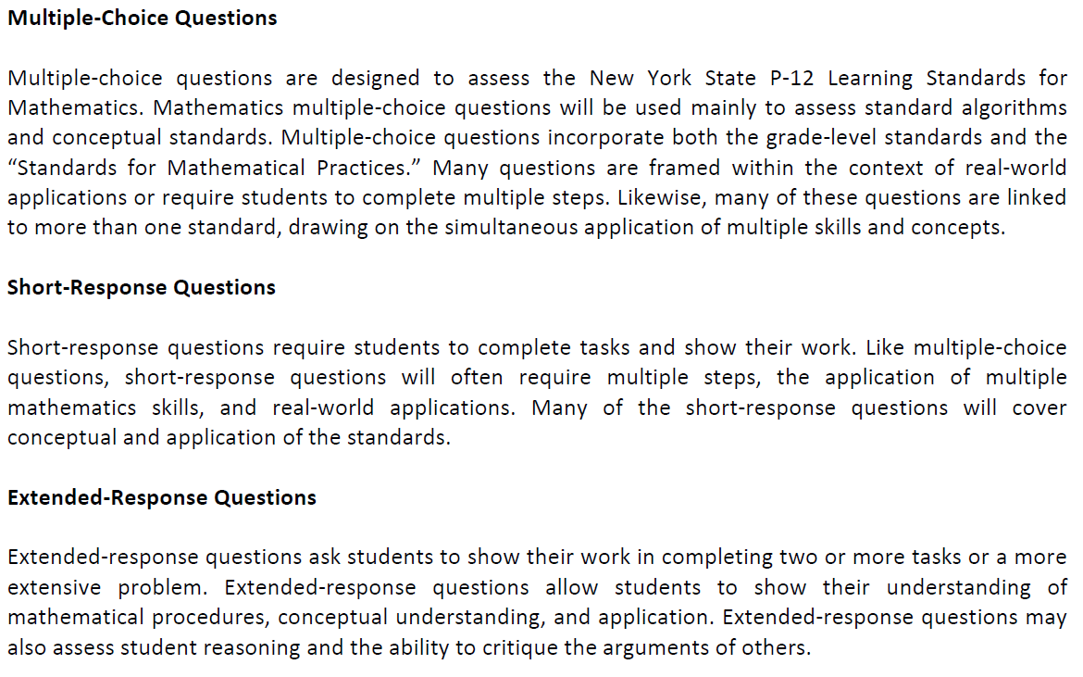
Types of Questions

Slide 7
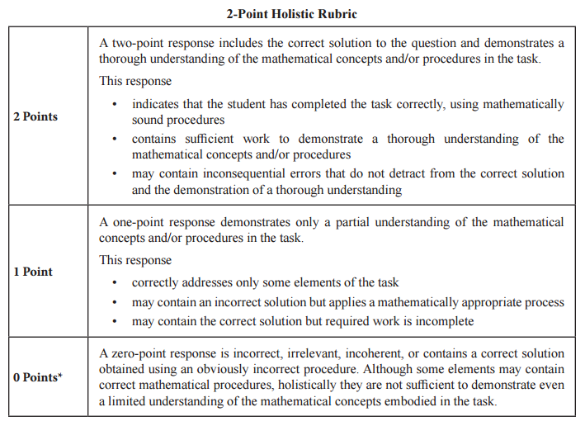
2-Point Rubric

Slide 8
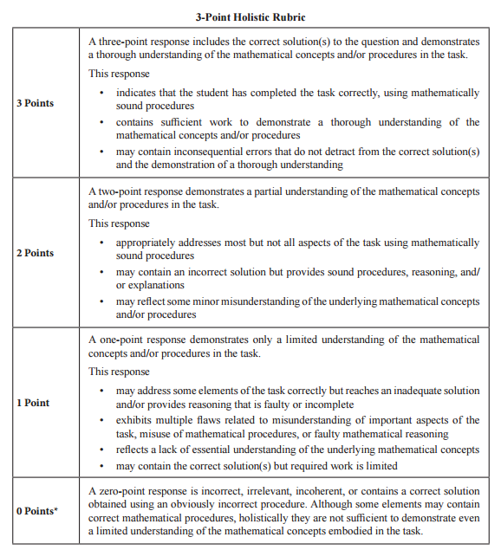
3- Point Rubric

Slide 9
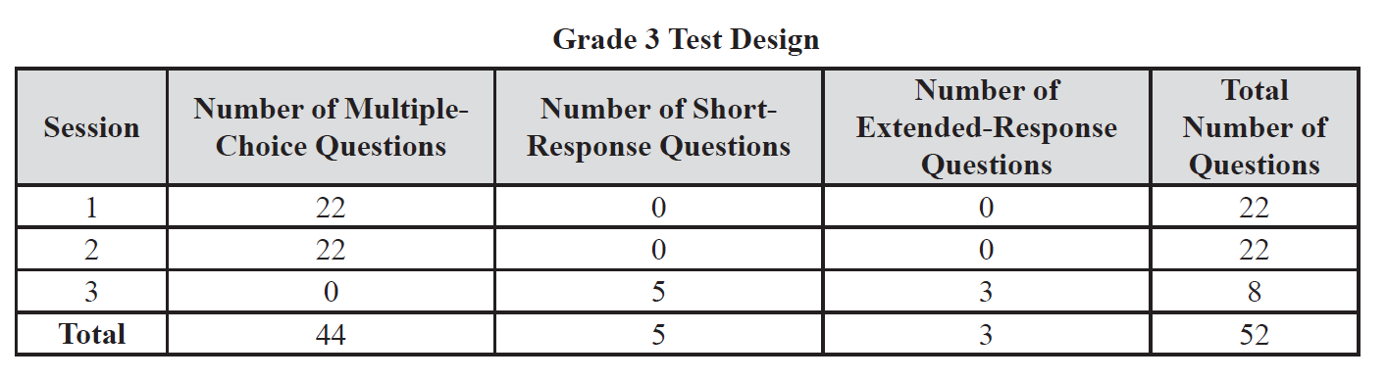
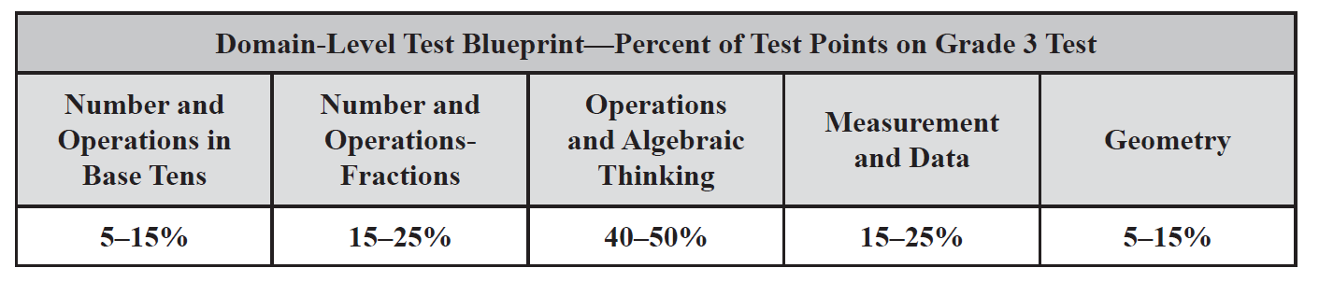
3rd Grade Test Structure

Slide 10
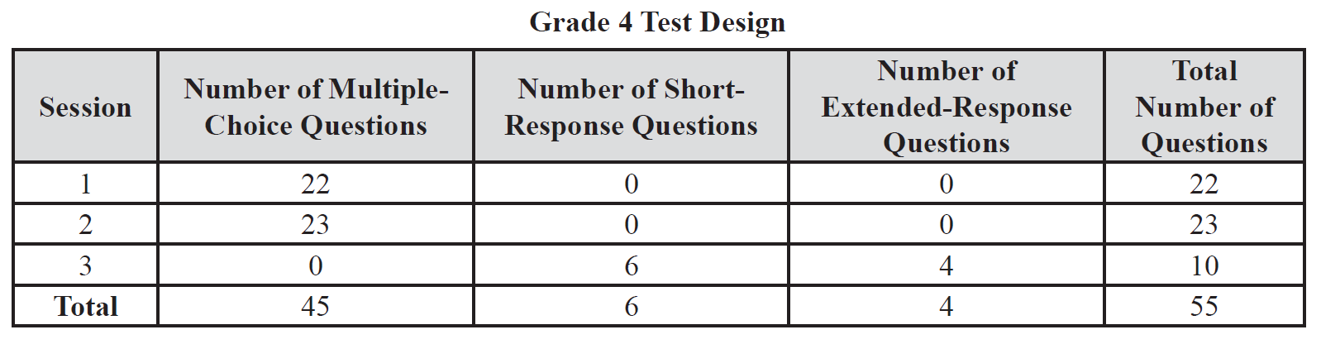
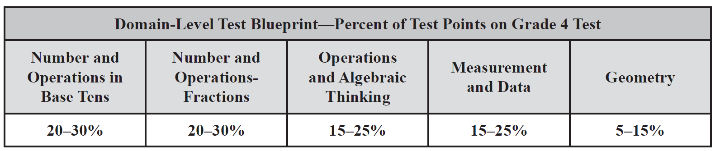
4th Grade Test Structure

Slide 11
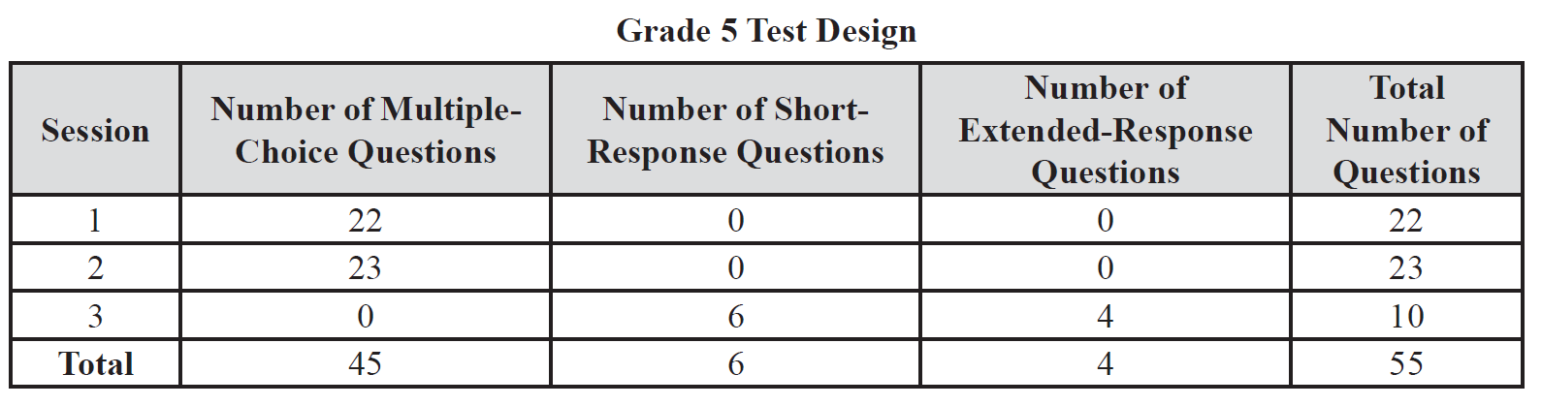
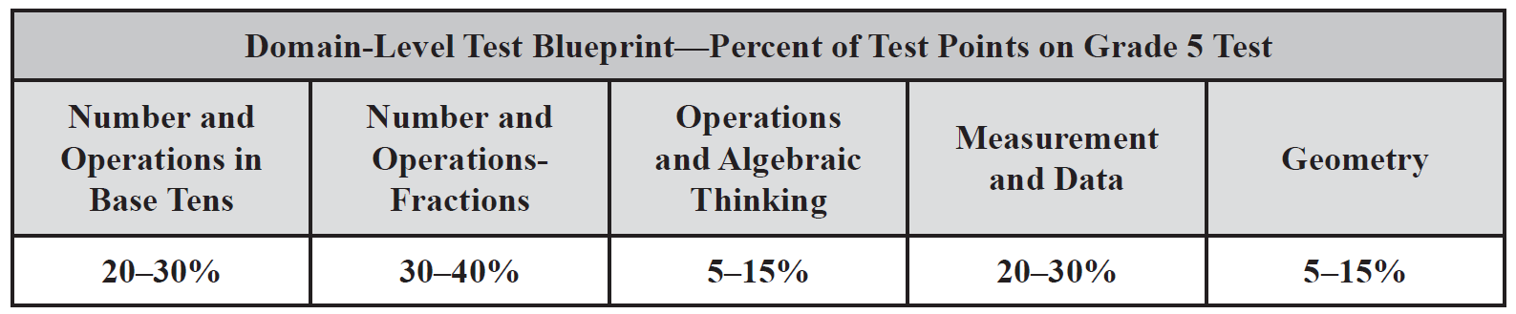
5th Grade Test Structure

Slide 12
At Home
Monitor daily homework
Practice addition, subtraction, multiplication and division facts at home
Turn everyday chores into math problems
Try these sites:
  www.IXL.com
  www.AAAmath.com
  http://www.math-play.com/
  http://www.engageny.org/
  http://www.tenmarks.com/

Slide 13
At Home

Slide 14
Problem Solving Steps
Steps to Close Reading of
Math Word Problems
First read: Get the gist of it
  What is this all about?
  What do I picture in my mind?
Second read: Get the meaning
  Sketch
  Annotate
Third read: Figure it out
  Solve, Check, Explain
Read the whole word problem.
Use reading comprehension strategies to make sense of the problem.
  Envision what is happening before solving
  Sketch what is happening in the “story”
Use a mathematical model to represent the situation
  Number line
  Array
  Ratio Table
  Double Number Line
  Money
Use your model to guide you in solving the problem
Check to make sure your answer makes sense AND answers the correct question

Slide 15
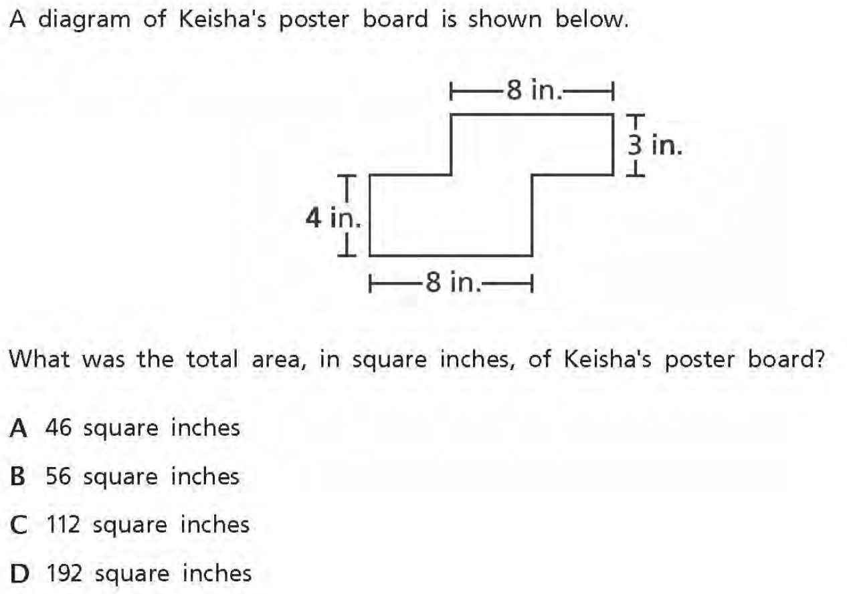
Grade 3

Slide 16
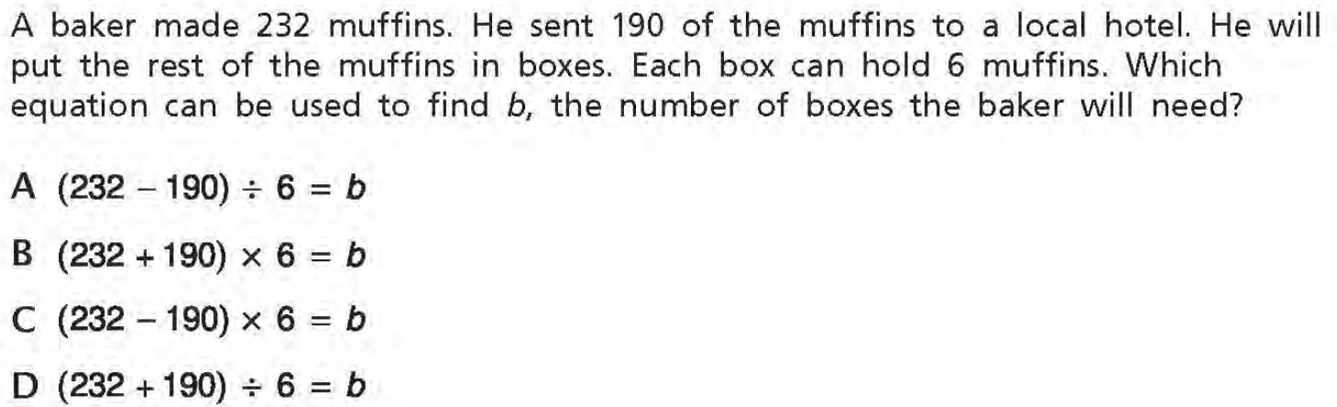
Grade 3

Slide 17
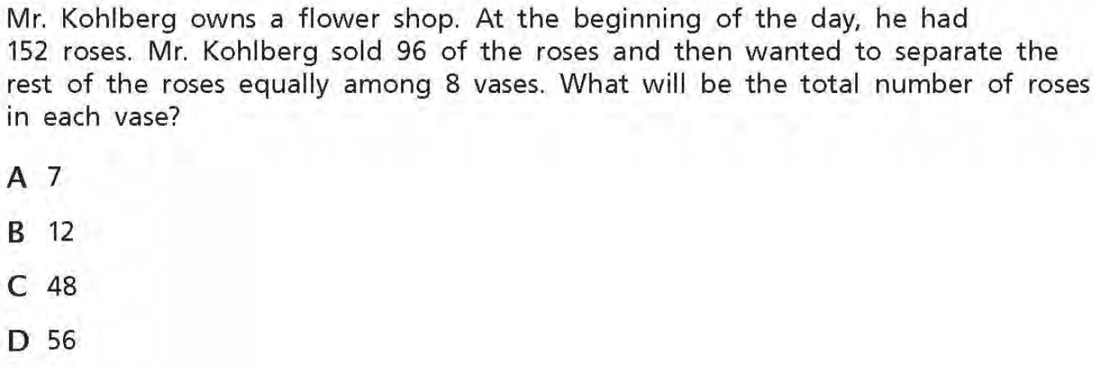
Grade 3

Slide 18
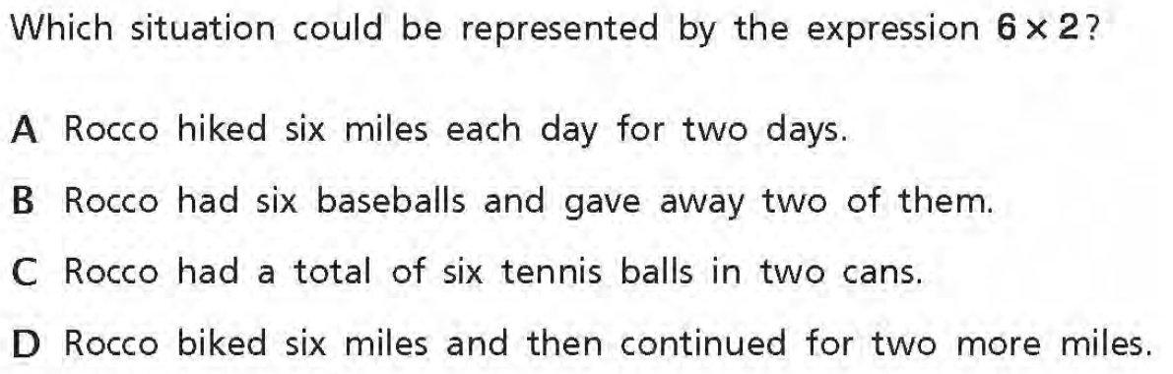
Grade 3

Slide 19
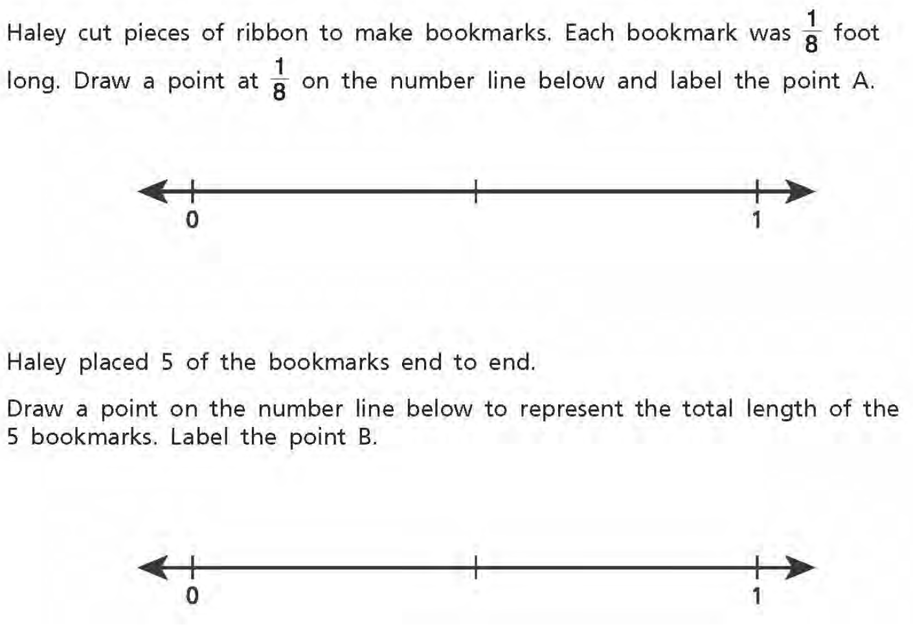
Grade 3

Slide 20
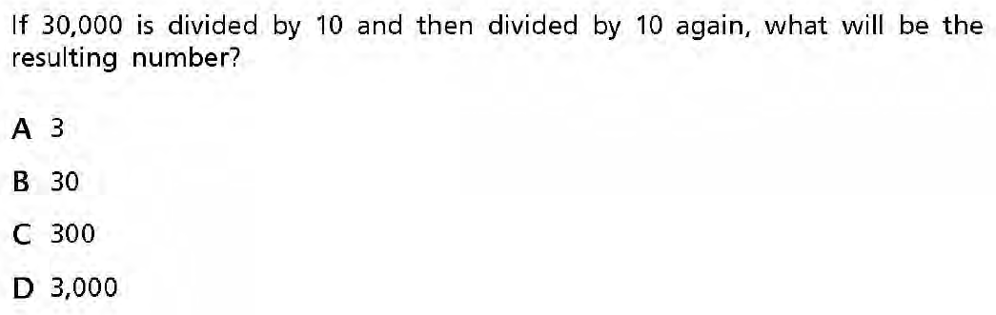
Grade 4

Slide 21
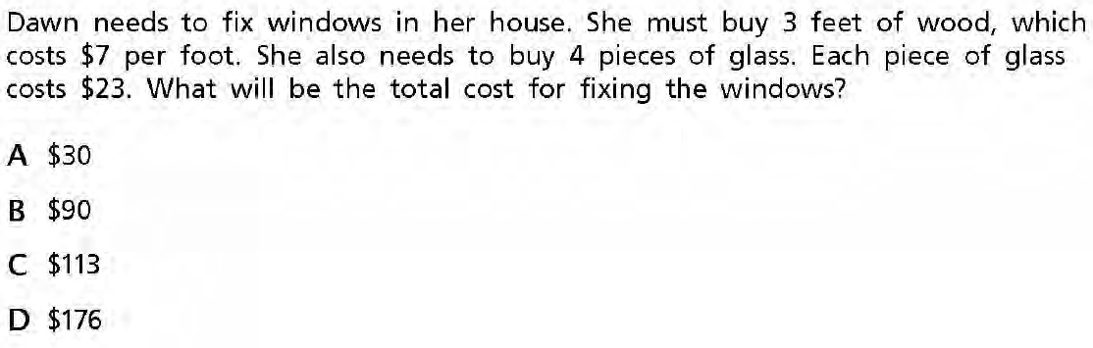
Grade 4

Slide 22
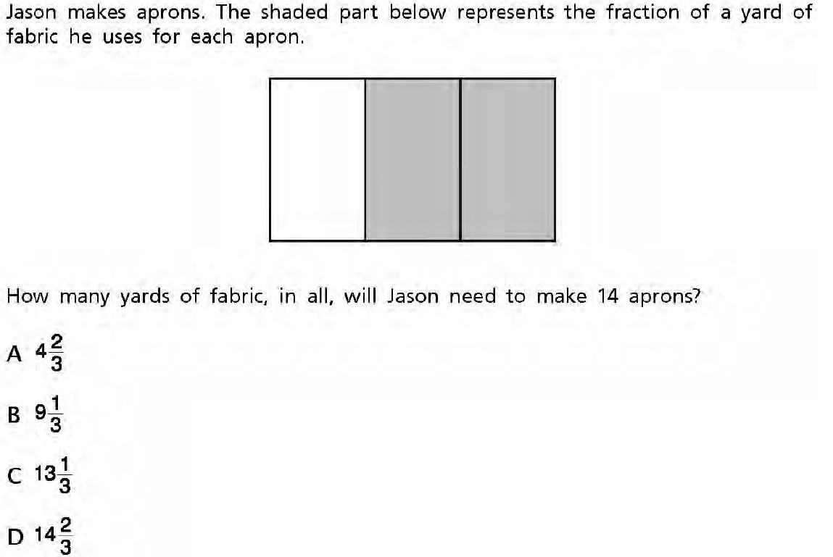
Grade 4

Slide 23
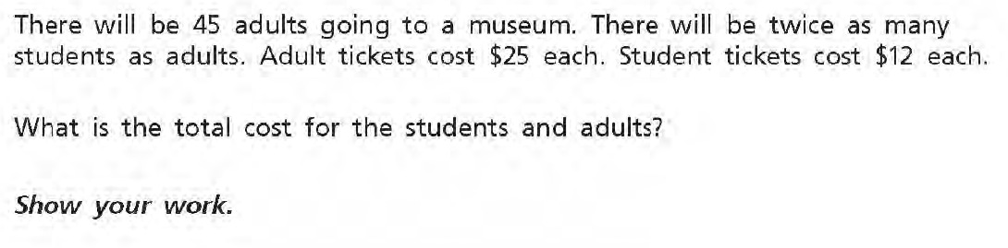
Grade 4

Slide 24
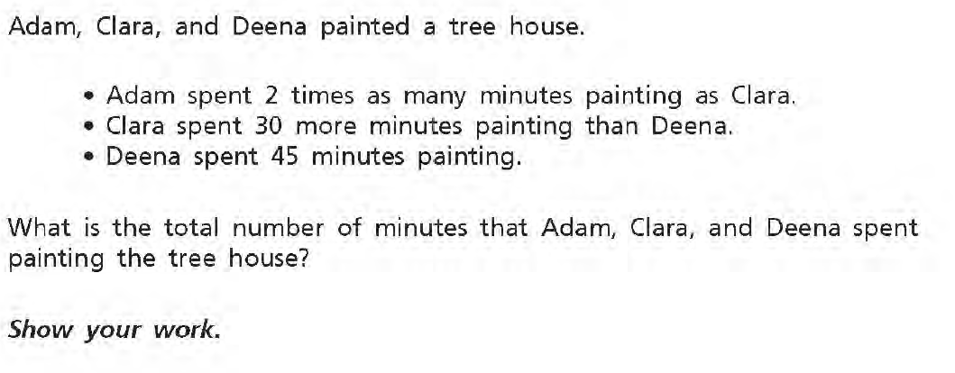
Grade 4

Slide 25
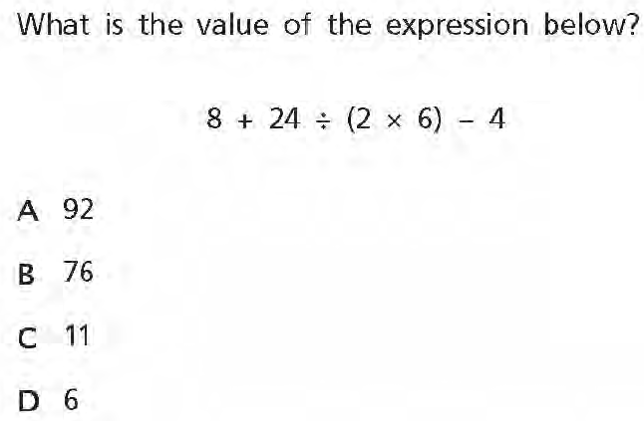
Grade 5

Slide 26
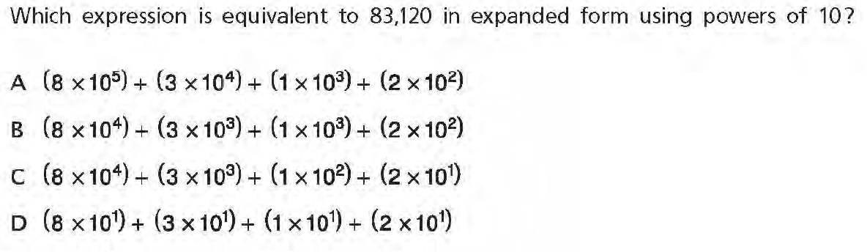
Grade 5

Slide 27
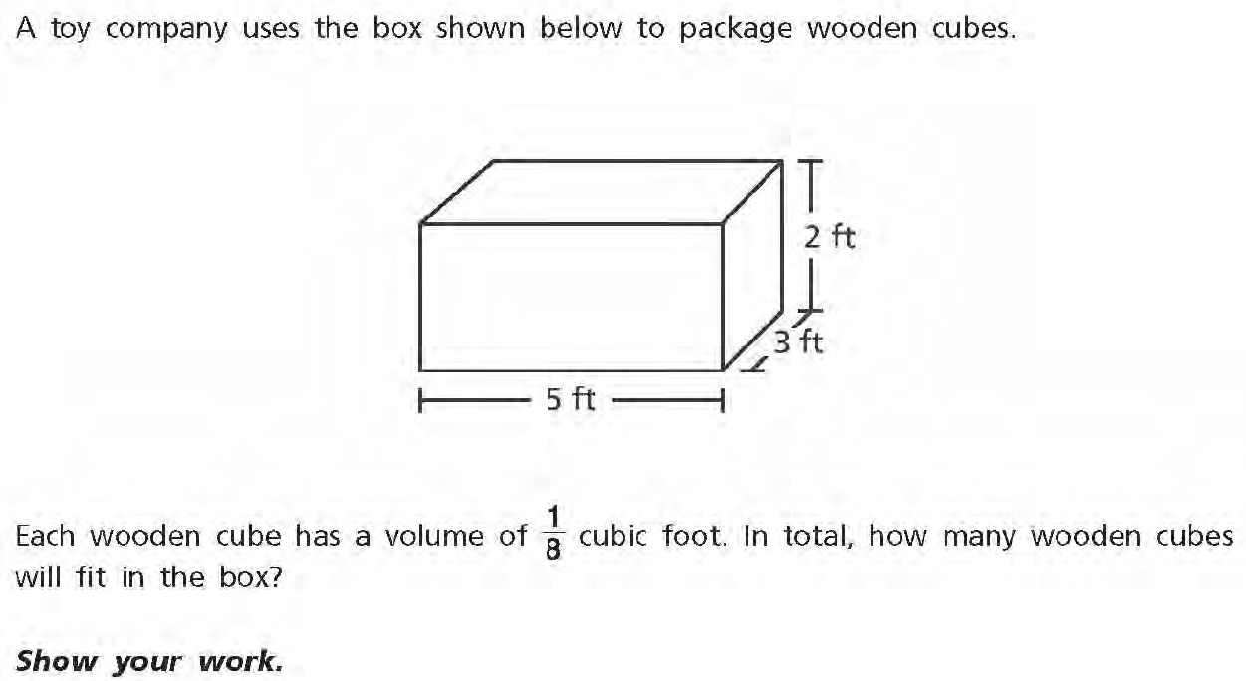
Grade 5

Slide 28
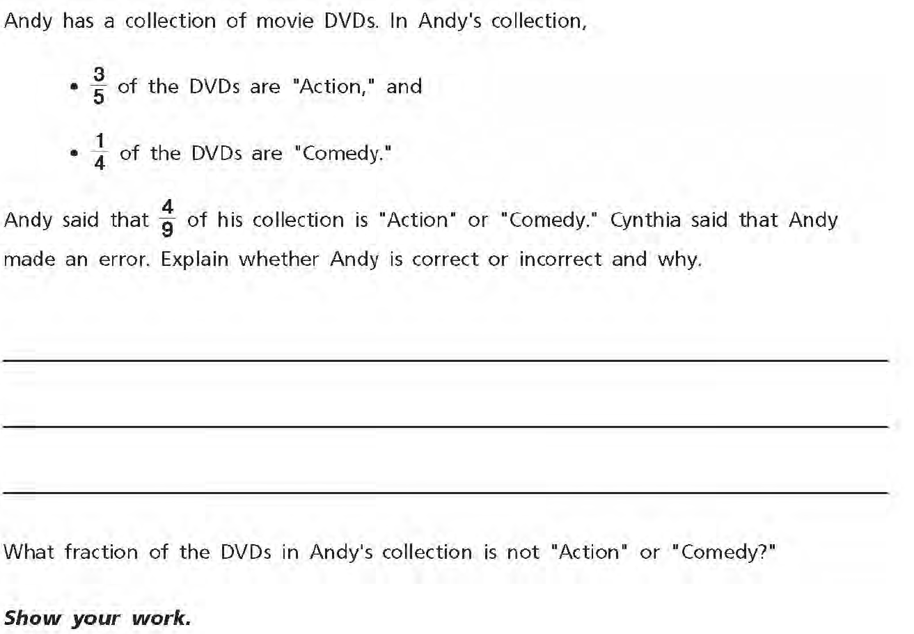
Grade 5

Slide 29
“If I had an hour to solve a problem I'd spend 55 minutes thinking about the problem and 5 minutes thinking about solutions.”
― Albert Einstein

